Slide 1
Layered System
API Architecture
Notes:
---- you should be able to describe what the layered system architecture is and identify the benefits of the layered system architecture

Slide 2
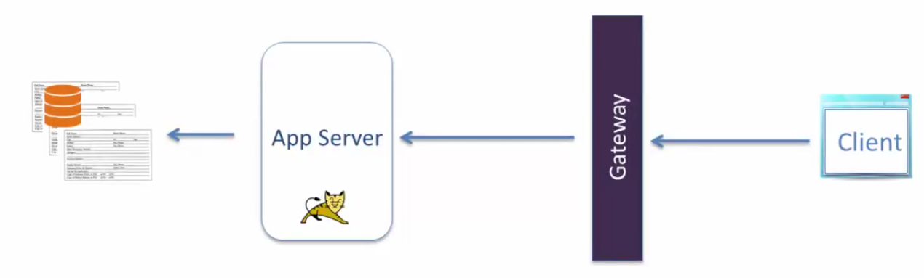
Layered System Architecture
Consist of multiple layers
No layer can see past the other
Layers moved, modified, added
Notes:
---- (CLICK) the layered system constraints state’s that the client-server architecture for REST API consist of multiple layers (CLICK)
--- consider the following architecture (CLICK) we have the client connecting to a gateway; which in turn is connecting to the app server layer; which intern is connecting to the database layer
----- the gateway layer does not know how the database layer is setup, the client layer only knows about the gateway layer; the client layer does not have any knowledge of the app server layer
---- Layers maybe moved, modified, added, and removed based on the needs of the over all architecture

Slide 3

Layered System Restrictions
Client should never connect directly to the app server or the database
Notes:
------ (CLICK) one restriction of the layered system is that the client should never connect directly to the app server or the database server (CLICK)
---- this kind of connection is never allowed; the reason behind this is because if the client were to connect directly to the app server will need to carry out the distribution of the request or the distribution of the load and the client should not have to do that.
--- in the need to add a load balancer (CLICK) due to high traffic (CLICK) the load balance should be conducted by the load balance and not the client;

Slide 4
Benefits of layer system
Simplifies the architecture
App sever layer may change
Request distribution
Notes:
------ one of the benefits of layered system architecture is that it hides the complexity of the various layers
----- (CLICK) the client layer doesn’t need to know that app server layer if it is connecting through the gateway
---- (CLICK) the app server layer can change over a period of time, and the change doesn’t necessary have to impact the client layer
----- (CLICK) the client do not need to worry about request distribution, the gateway or load balance can take care of the request distribution

Slide 5
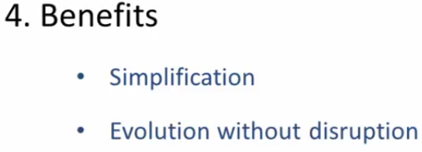
Summary
Notes:
Call on students to explain summary

